Slide 1
IARU Championship
Objective: to contact as many other amateurs, especially IARU member society HQ stations, around the world as possible using the 160, 80, 40, 20, 15 and 10 meter bands.

Slide 2
IARU
The second full weekend of July, beginning 1200 UTC Saturday and ending 1159 UTC Sunday (July 13-14, 2019). Both Single and Multi operator stations may operate the entire 24-hour period.
The starting time is (finally) great for here, as the contest starts at 7 am, so we can get a good sleep in and get up and hit it!

Slide 3
IARU Entry Classes
4.1. Single Operator
4.1.1. Categories
4.1.1.1. Phone only – High, Low and QRP power levels
4.1.1.2. CW only – High, Low, and QRP Power levels
4.1.1.3. Mixed mode – High, Low and QRP Power levels
4.1.2. One person performs all operating and logging functions.
4.1.3. Use of spotting nets, packet, or multi-channel decoders (such as CW Skimmer) is not permitted. Single-operator stations that use spotting nets, packet or multi-channel decoders will be reclassified to the applicable Single Operator Unlimited category.
4.1.4. All operators must observe the amateur radio regulations of their country at all times.
4.1.5. Single operator stations are allowed only one transmitted signal at any given time.

Slide 4
IARU Entry Classes
4.2. Single Operator Unlimited
4.2.1. Categories
4.2.1.1. Phone only – High, Low and QRP power levels
4.2.1.2. CW only – High, Low, and QRP Power levels
4.2.1.3. Mixed mode – High, Low and QRP Power levels
4.2.2. One person performs all operating and logging functions.
4.2.3. All operators must observe the amateur radio regulations of their country at all times.
4.2.4. Single operator stations are allowed only one transmitted signal at any given time.

Slide 5
IARU Entry Classes
4.3. Multi Operator, Single Transmitter, Mixed Mode Only
4.3.1. Must remain on a band and mode for at least 10 minutes before changing bands or modes. There are no exceptions. The “10 minute clock” starts when a QSO is logged.
4.3.2. Only one transmitted signal is allowed at any given time. There are no exceptions.
4.3.2.1. Alternating CQs on two or more frequencies on the same band is not permitted.
4.3.3. All operators must observe the amateur radio regulations of their country at all times.
4.3.4. Violation of the band change rules will reclassify the entry as a checklog.

Slide 6
IARU HQ Station
4.4. IARU Member Society HQ Station
4.4.1. May have only one transmitted signal per band mode (160 CW, 160 Phone, 80 CW, 80 Phone, 40 CW, 40 Phone, 20 CW, 20 Phone, 15 CW, 15 Phone, 10 CW, 10 Phone) at the same time.
4.4.2. All stations involved in an HQ operation must be in a single ITU zone.
4.4.3. Only one HQ station callsign per member society per band mode is permitted (160 CW, 160 Phone, 80 CW, 80 Phone, 40 CW, 40 Phone, 20 CW, 20 Phone, 15 CW, 15 Phone, 10 CW, 10 Phone).

Slide 7
The IARU Exchange Info
5.1. IARU member society HQ stations send signal report and official IARU member society abbreviation. IARU International Secretariat club station NU1AW counts as a HQ station.
Members of the IARU Administrative Council and the three IARU regional Executive committees send “AC,” “R1,””R2,” and “R3” as appropriate.
5.2. All others send signal report and ITU zone.

Slide 8
QSO Points
7. QSO Points:
7.1. Contacts within your own ITU zone, as well as QSOs with any IARU-member society HQ station or IARU official (counting as the special multiplier), count one point each.
7.1.1. Contacts with a station in the same ITU zone but on a different continent count one point.
7.2. Contacts within your continent (but different ITU zone) count three points.
7.3. Contacts with a different continent and IARU zone count five points.

Slide 9
Mults-Mults-Mults
8. Multipliers: The total number of ITU zones plus IARU member society HQ stations worked on each band (not mode). IARU officials represent a maximum of four multipliers per band (AC, R1, R2 and R3).
8.1. IARU member society HQ stations and officials do not count for zone multipliers.

Slide 10
Send it in ASAP!
10.1. New 5-day log submission deadline. Entries must be uploaded to the web app or postmarked no later than 5 days after the end of the contest (1200 UTC July 19, 2019).

Slide 11
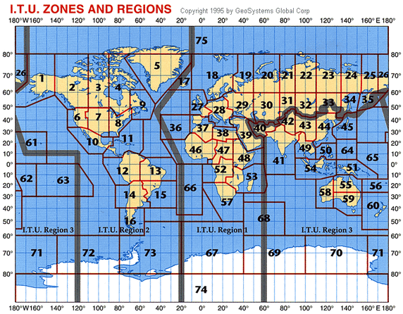
ITU Zone Map

Slide 12
2018 IARU Results
https://contests.arrl.org/ContestResults/2018/IARU-HF-2018-FinalFullResults.pdf
A few top results from this club in 2018:
CW HP S/O W5KFT (K5PI op) #7 US, N3BB #9 US
CW LP S/O Unlimited AE5GT
PH HP S/O Unlimited K5LLA
CW HP S/O Unlimited AC4CA
M/S Mixed HP K5TR #1 US!!!!

Slide 13
Some Tips
This contest allow everyone to work everyone for points. Three points for “East” and “West” and 1 point for “Central” US. Five points for other continents. (See US map for details if needed)
Contacts for non-NA are worth five points.
Contacts with ITU HQ stations are worth one point.
Mults are key to a great score: Zones and ITU HQ stations (plus a few others like ITU area reps, etc.)

Slide 14
N3BB-2018 IARU Rate Chart
Hour (Zulu) |  | 160CW | 80CW | 40CW | 20CW | 15CW | 10CW
12 |  | 0 | 0 | 11 | 126 | 6 | 0
13 |  | 0 | 0 | 0 | 52 | 53 | 10
14 |  | 0 | 0 | 0 | 66 | 59 | 2
15 |  | 0 | 0 | 0 | 105 | 8 | 24
16 |  | 0 | 0 | 0 | 15 | 121 | 0
17 |  | 0 | 0 | 0 | 20 | 77 | 0
18 |  | 0 | 0 | 0 | 77 | 15 | 18
19 |  | 0 | 0 | 0 | 23 | 29 | 12
20 |  | 0 | 0 | 0 | 17 | 54 | 10
21 |  | 0 | 0 | 0 | 45 | 31 | 1
22 |  | 0 | 0 | 0 | 114 | 1 | 0
23 |  | 0 | 0 | 0 | 66 | 0 | 0
0 |  | 0 | 0 | 14 | 82 | 0 | 0
1 |  | 0 | 0 | 23 | 42 | 0 | 0
2 |  | 0 | 8 | 92 | 0 | 0 | 0
3 |  | 2 | 21 | 52 | 0 | 0 | 0
4 |  | 3 | 21 | 86 | 0 | 0 | 0
5 |  | 9 | 28 | 72 | 0 | 0 | 0
6 |  | 10 | 41 | 29 | 0 | 0 | 0
7 |  | 1 | 30 | 41 | 0 | 0 | 0
8 |  | 8 | 4 | 49 | 0 | 0 | 0
9 |  | 5 | 19 | 50 | 0 | 0 | 0
10 |  | 0 | 22 | 41 | 0 | 0 | 0
11 |  | 0 | 7 | 86 | 0 | 0 | 0

Slide 15
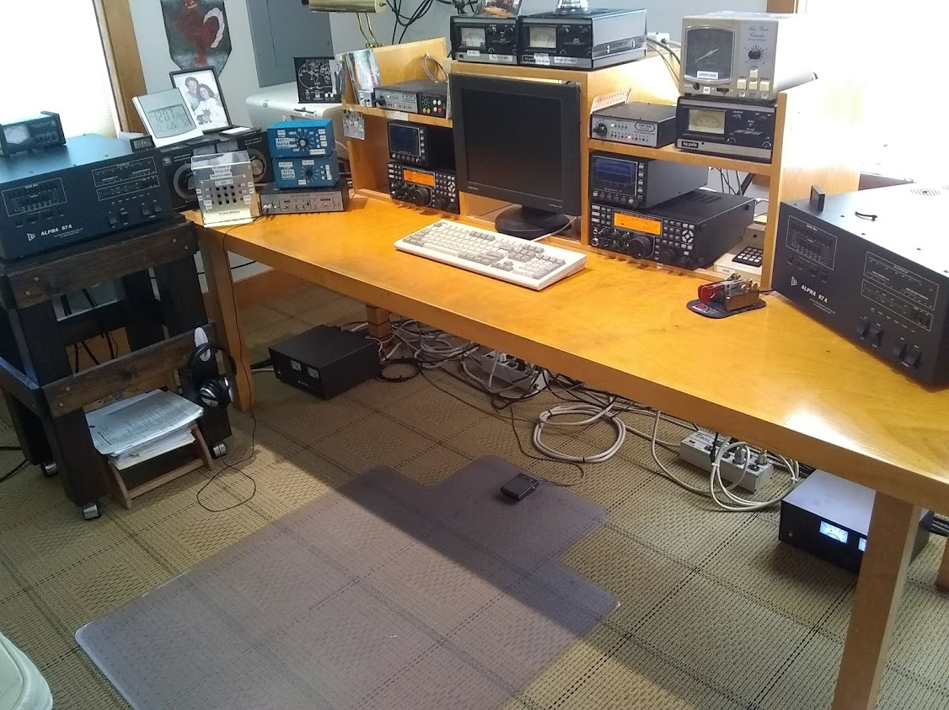
N3BB SO2R Operating Position

Slide 16
But There’s More!
The NS (NCCC Sprint) CW Thursday Night Madness-the mini-sprint
Only 30 minutes long, 0230-0300Z (Friday Zulu)
Five bands, with 5-10 mins/band max (no 10)
High speed, 30-38 WPM, but 20-25 WPM is acceptable (WA6URY remote from Tokyo)
039-048 on all but 160 (015-018)

Slide 17
NS … Continued
Start on the highest band open, and QSY lower in freq. End up on 80 or 160.
Mults count on each band.
Exchange: #, Name, State
Sprint QSY rules (the only way to beat “The Force” .. K5NA) … smiley face here ☺
CQ and QSO and QSY
S&P call a CQer, QSO, and then stay 1 QSO.

Slide 18
“Sprint QSY Format” is important
CQ NS W9RE (Short and sweet CQ)
N3BB (One call only unless needed)
N3BB W9RE #100 MIKE IN (Note, W9RE send his call at front)
W9RE #98 JIM TX N3BB (Note, N3BB sends his call at the end)
R (Note, essential to wait for QSL)
(W9RE Must QSY away to a different freq or different band)
KZ5D
KZ5D N3BB 99 JIM TX (N3BB sends his call at the front end)
N3BB #96 ART LA KZ5D (KZ5D’s call is at the end)
TU (QSL at end confirms all OK, no repeats needed…
N4AF (N4AF calls knowing he is calling KZ5D)
N4AF KZ5D #97 ART LA
etc

Slide 19
NS Sprint
Not a lot of Tejas activity: N3BB, KG5U for the most part, with K0NM occasionally.
We are “King” on 15 and 20, with East to West propagation
Ditto on 40. Yeah!
We struggle on 80, as too far from the East and Midwest concentration
Good luck on 160!

Slide 20
That’s All, Folks!
Questions?

